Slide 1
High Performers Are More Agile
46x
440x
more frequent deployments
faster lead times than their peers
Source: Puppet/DORA: 2017 State Of DevOps Report: https://puppet.com/resources/whitepaper/state-of-devops-report

Slide 2
High Performers Are More Reliable
5x
96x
lower change failure rate
faster mean time to recover (MTTR)
Source: Puppet/DORA: 2017 State Of DevOps Report: https://puppet.com/resources/whitepaper/state-of-devops-report

Slide 3
High Performers Do Cool Stuff
21%
44%
less time spent on unplanned work and rework
more time spent on new work
Source: Puppet/DORA: 2017 State Of DevOps Report: https://puppet.com/resources/whitepaper/state-of-devops-report

Slide 4
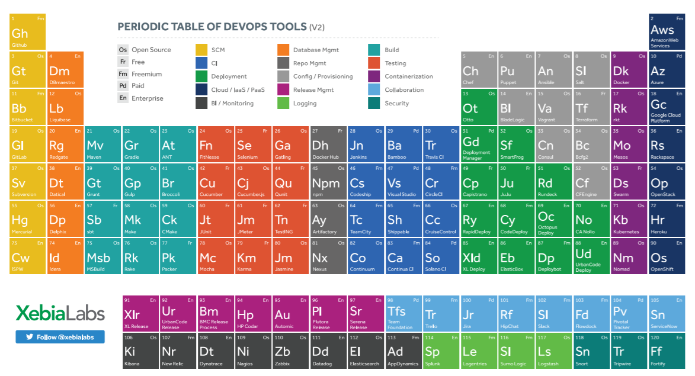
So Many Tools!
Notes:
What is minimum tool set needed in DevOps?

Slide 5
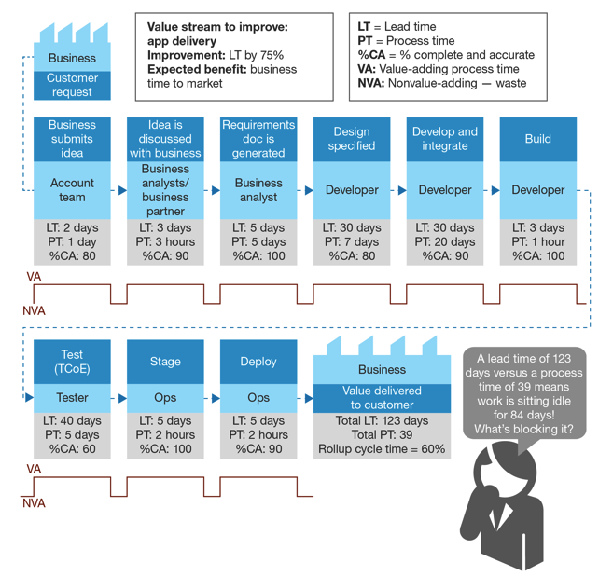
Organizational Challenges
Wait time Typically > Task Time
Root Causes
Role Silos
Sharing Resources Across Projects
Lack of a “Product Team” model

Slide 6
Scaling Challenges
Departmental Success != Enterprise-wide Success
Compliance
Visibility
Maintainability
Repeatability
Technical and Non-technical Participants

Slide 7



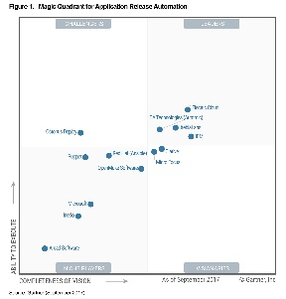

Enterprise DevOps Platform intelligence, automation and control
Learn more: www.youtube.com/xebialabs
Hundreds of Companies deliver software with XebiaLabs - faster, safer and more customer focused
Top-ranked
Continuous Delivery and DevOps pioneer, authority and technology leader
Global team in the US, Europe & APAC

Slide 8
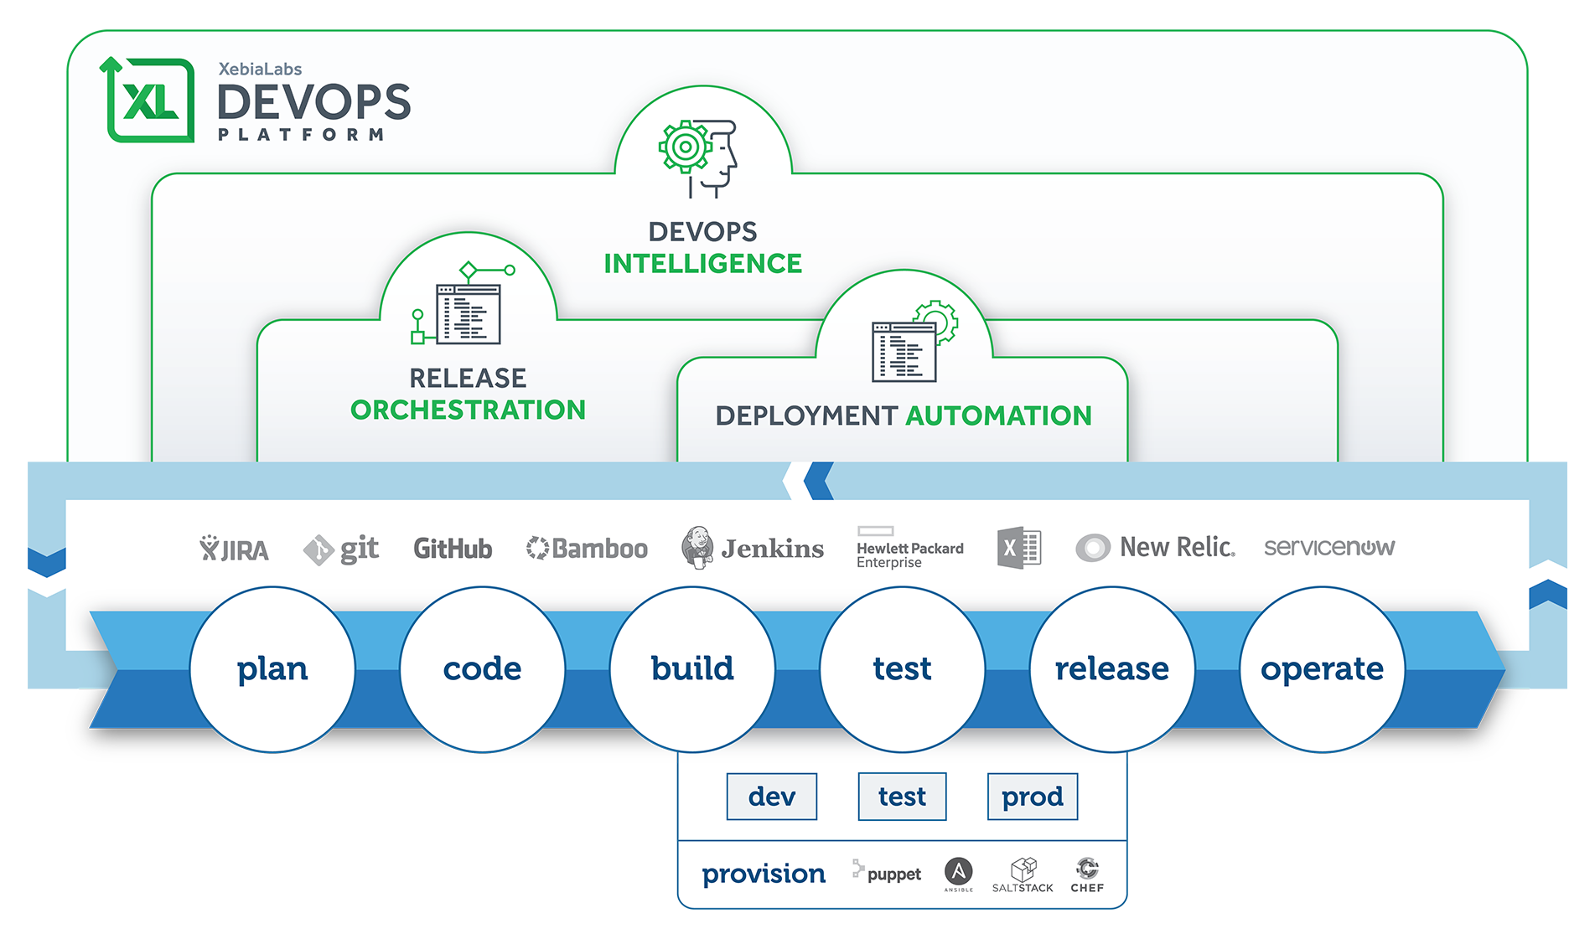
XebiaLabs Platform

Slide 9
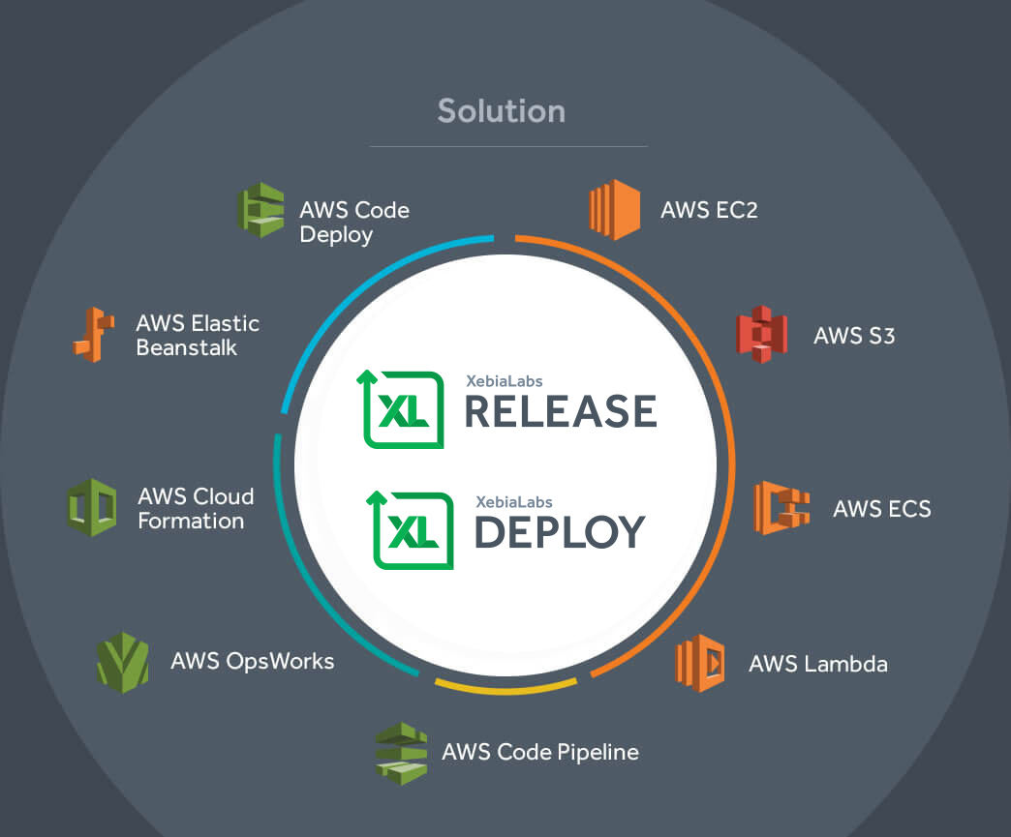
AWS DevOps Competency Partner

